Slide 1
Mapping Learning Outcomes and Setting Standards
Dr Marie Stowell, Director of Quality and Educational Development,
Catriona Robinson, Deputy Head of Institute of Education (Quality/External Inspection/Verification)
Jen Zandbeek, Acting Head of Academic Quality
January 2018

Slide 2
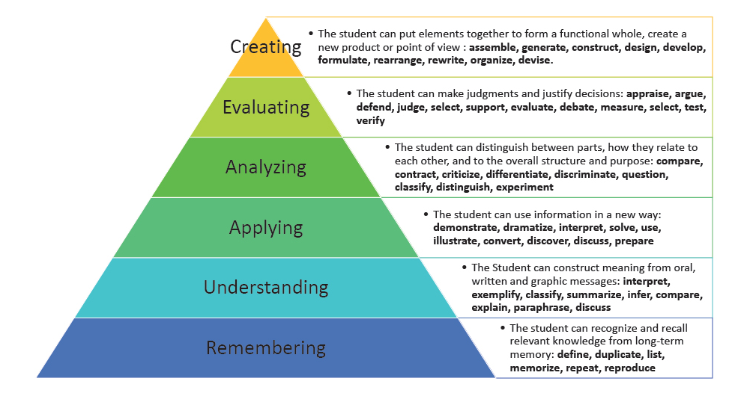
Mapping Learning Outcomes to Modules and Awards: Guidance for course design
Bloom’s Revised Taxonomy
Anderson, L. W., & Krathwohl, D. R. (eds.) (2001)

Slide 3
Note: throughout this presentation the focus is on
Honours degrees - the principles are the same for
other awards but the level is different

Slide 4
Writing learning outcomes: reference points
FHEQ qualification descriptor
Subject benchmark statement
Characteristics statements (Masters, FDs etc)
Professional body requirements
UW Curriculum Design policy
UW Principles for course design guidance documents
Undergraduate courses
Foundation degrees
Writing learning outcomes and assessment criteria
Notes:
FHEQ provides a benchmark for setting standards – specifies the general criteria for an award at a particular level – use the language of the descriptor in writing the learning outcomes
Subject benchmark statement provides a benchmark for setting standards and designing a curriculum in specific subject in terms of scope, content, learning and teaching, and outcomes at threshold (and sometimes typical) levels
Characteristics statements set out expectations for courses of a particular type – sets framework for design
PSRB requirements for professional training courses
UW Curriculum design policy sets out general principles for design of UW courses in terms of credit principles and curriculum themes
UW Principles for ….. Guidance documents for design of Hons degrees, FDs, and writing learning outcomes and assessment criteria

Slide 5
Writing learning outcomes: process
What are the distinctive features of the course?
What will students have learnt and be able to do if they successfully complete the course?
Use active and explicit verbs – ensure these are appropriate to the level of the award
Recommend 10 – 16 points for the course learning outcomes
Think about how modules and course structure, and learning, teaching and assessment will align with learning outcomes
Iterative process?
NB: course learning outcomes must be achievable by all students
Notes:
Good course learning outcomes – what students will know and be able to do on successful completion of the course (informed by the reference points) - will set the framework for the design and delivery of the course and will define the standards of achievement expected.
Ideal process: agree the learning outcomes – decide the assessment strategy in broad terms – set out the course structure in terms of modules – agree the learning and teaching strategy for the course – revise and tweak all elements – ensure constructive alignment – write the modules and the programme specification
Iterative process: draft the learning outcomes – identify the modules for each level of the award – map the assessments – review alignment – make modifications in terms of modules and/or assessment and/or course learning outcomes – agree approach to learning and teaching and assessment strategy
Practical advice for writing learning outcomes:
10 – 16 separate outcomes
If use sub-headings think about where you position outcomes
Don’t write learning outcomes too generically (so could be an award in anything)
Ensure outcomes cover the course USP
Write skills based learning outcomes to reflect level of award
Don’t include things that are not directly summatively assessed

Slide 6
Course Design Process Biggs’ model of constructive alignment (2003)

Slide 7
Learning outcomes: curriculum thinking
How will you ensure and support progression and develop high level academic skills development, eg critical analysis + evaluation skills?
How will you stretch and challenge students and personalise learning?
How will you maximise the chances of graduates entering highly skilled employment?
What transferable and discipline related skills will you develop in students? NB: digital capabilities
Do the learning outcomes reflect the course USP?
Notes:
Good course design = a challenging, engaging and stimulating student learning experience – needs to be thought through
Good course design focuses on coherence, progression and alignment across modules – a good course is more than the sum of its parts. Is the course a set of discrete learning experiences based on individual modules, or is the course a coherent whole where learning development is planned and progressive?
Is the development of higher order skills left to chance or planned and supported?
Things to think about (and possibly reflect in the course design)
Role of personal academic tutoring (all evidence suggests it works best when embedded in academic programme; embedded means relevant, aligned, scheduled, clear purpose, valued as part of the learning programmes for students)
What skills and capabilities underpin success in the course – how are all students stretched, and how are all students supported to acquire the skills and capabilities?
How is the development of employability embedded across the course and how are students prepared for getting highly skilled jobs?
Research informed teaching … of various kinds
The development of student digital capabilities should be explicitly considered and reflected in learning outcomes.

Slide 8
Mapping learning outcomes to modules
Focus on the level 6 and level 5 modules only
Consider in which modules (at level 5/6) the learning outcome will be primarily assessed. If it is via all modules or all optional modules or all mandatory modules – state this BUT if you use this a lot, perhaps the outcomes are too generic
Normally only one or two modules should be mapped to individual learning outcomes
Ideally this is a process of curriculum design and planning to align the modules, learning, teaching and assessment with the learning outcomes
Notes:
Learning outcomes should be written at the exit level of the award (therefore focus will be on how these are assessed at exit level)
If you find you are listing lots of modules against a learning outcome consider:
Does this mean the learning outcomes are not directly assessed (consider deleting or re-drafting it)
If it is genuinely important and assessed through multiple modules consider stating ‘all modules’ or ‘all M modules’ or ‘all O modules’
Focus more directly on the assessment strategy for the course and the module/s – if the learning outcome is important where is it being assessed (assessment mode may have significant impact)
3. Normally the M modules will be focus for achievement of a good proportion of the learning outcomes (as all students must be able to achieve them).
4. Some learning outcomes should be achievable by taking any optional modules (this implies there are things optional modules have in common in terms of assessment) so that whichever optional module/s a student takes they will still (if successful) achieve the learning outcome.

Slide 9
Non-Honours and Honours exit award
NB: Non-Honours award is no longer ‘any 60 credits at level 6’ – must have met learning outcomes and taken modules that justify award title
Learning outcomes for non-Honours will normally not include reference to independent study/project work and associated module
Normally students exiting with a non-Honours degree will be expected to have passed at least 60 credits of the mandatory modules (excluding the independent study or project module) at level 6
In all cases the modules passed must justify the award title
Please seek advice if you are not sure how to express this (section 20)
Notes:
The UK Quality Code specifies that awards must be made on the basis of positive achievement of learning outcomes, and not as a ‘default’ for failing a higher level award ….. Must therefore specify the learning outcomes for exit awards.
There will be some students who meet credit criteria eg for a non-Honours award, but do not meet the requirements for the award because they have not completed the specified modules – they will get a transcript.
General principle is that to be eligible for non-Honours students must have passed M modules at level 6 (not including the IS module). NB: Can be slightly more complex if the course has more than 60 M credits …… CONSULT via AQU

Slide 10
Cert HE and DipHE: Standard text
Learning Outcomes: Diploma in Higher Education [insert name of exit award]
In order to be eligible for the exit award of Diploma in Higher Education in the named subject/area of study, a student must have passed at least 240 credits in total including the mandatory modules for level 4 and level 5 of the award as specified on the award map.
Learning Outcomes: Certificate in Higher Education [insert name of exit award]
In order to be eligible for the exit award of Certificate in Higher Education in the named subject/area of study, a student must have passed at least 120 credits in total including the mandatory modules for level 4 of the award as specified on the award map.
Notes:
We agreed a position for Cert HE and Dip HE that does not involve setting out learning outcomes … simply that the student must have passed sufficient credit for the award and that this includes the M modules.
The standard text must be included if you have exit awards for Cert HE and Dip HE.

Slide 11
Integrated Masters
IM purpose: to provide opportunity for students to continue their studies at UW and gain a Masters qualification
Preferred model: BA/BSc/IM – ie a level 7 year added to an existing BA/BSc and therefore:
Normally set out as part of a single BSc/BA/IM Programme Specification
Some examples of ‘niche’ programmes (ie not related to existing undergraduate awards)
Learning outcomes for level 7 set out separately
Notes:
Be clear about purpose of IM, how it ‘adds value’ and any recruitment risks
The preferred model for UW IM courses is to build a level 7 programme on to an existing successfully recruiting BA/BSc (Hons) programme, through the possibility of a combination of internship, placement activity, research based learning and taught modules.
If there is an existing ‘free-standing’ MA/MSc etc, the IM level 7 must be distinct from this – although some modules can be shared.
Note: there are differences in the fee/loans for IM and for MA/MSc, so if there are similar/alternative routes to Masters in a subject area students should be appropriately advised.
You MUST use the FHEQ Masters qualification descriptor to inform the learning outcomes for the IM level 7.
All IM must take and pass a dissertation or other substantial piece of independent work to be eligible for a Masters award.

Slide 12
Joint subject pathways: standard text
Learning Outcomes: Joint Pathway
Students following a joint pathway will have met the majority of the learning outcomes for the subject, although the range of knowledge and discipline specific understanding in terms of options or specialisms will be more restricted than for a single or major Honours student.
Learning Outcomes: Major Pathway
Students following a major pathway will have met the learning outcomes for the subject but will have focused their studies in relation to subject options or specialisms.
Learning Outcomes: Minor Pathway
Students following a minor pathway will have met some of the learning outcomes for the subject (as indicated by the modules studied), and will have focused the development of their knowledge, understanding and subject specific skills in particular aspects of the discipline.
Notes:
We agreed a position for Joint awards that does not involve setting out the learning outcomes separately for each pathway, and hence the standard text should be included in the programme specification.
It is, however, important to ensure that the available modules for each pathway are specified in such a way at levels 5 and 6 to ensure a student takes modules that justify the subject being included in the award title.

